Slide 1
Intro to Data Science using Python
MLDA@EEE Academic Club
Subcom : Wei Kai

Slide 2
Table of contents
01
02
03
04
Basic Python
Graphs
Getting ourselves familiar with python!
Refresher on basic statistics ☺
Data Science
Solving problems
What is Data Science?
Coding time!!!

Slide 3
01
Basic Python
Download and open the jupyter notebook file provided!

Slide 4
02
Graphs
Time to refresh on basic statistics

Slide 5
Statistics
Mean
Variance
Adding all numbers in the data set, then dividing by the number of values in the set.
The average of squared deviations from the mean
Mode
Mean Square Error
The number that occurs most often in a data set
MSE measures how close a regression line is to a set of data points. Average of the errors squared from data to the regression line

Slide 6
Statistics
Median
Inter Quartile Range
50% of datapoints will have a value lesser than or equal to the median.
The value of Q3-Q1
Quartiles Q1 & Q3
Outliers
25% of datapoints will have a value lesser than Q1
75% of datapoints will have a value lesser than Q3
Datapoints lesser than
Q1 – 1.5 x IQR
Datapoints more than
Q3 + 1.5 x IQR

Slide 7
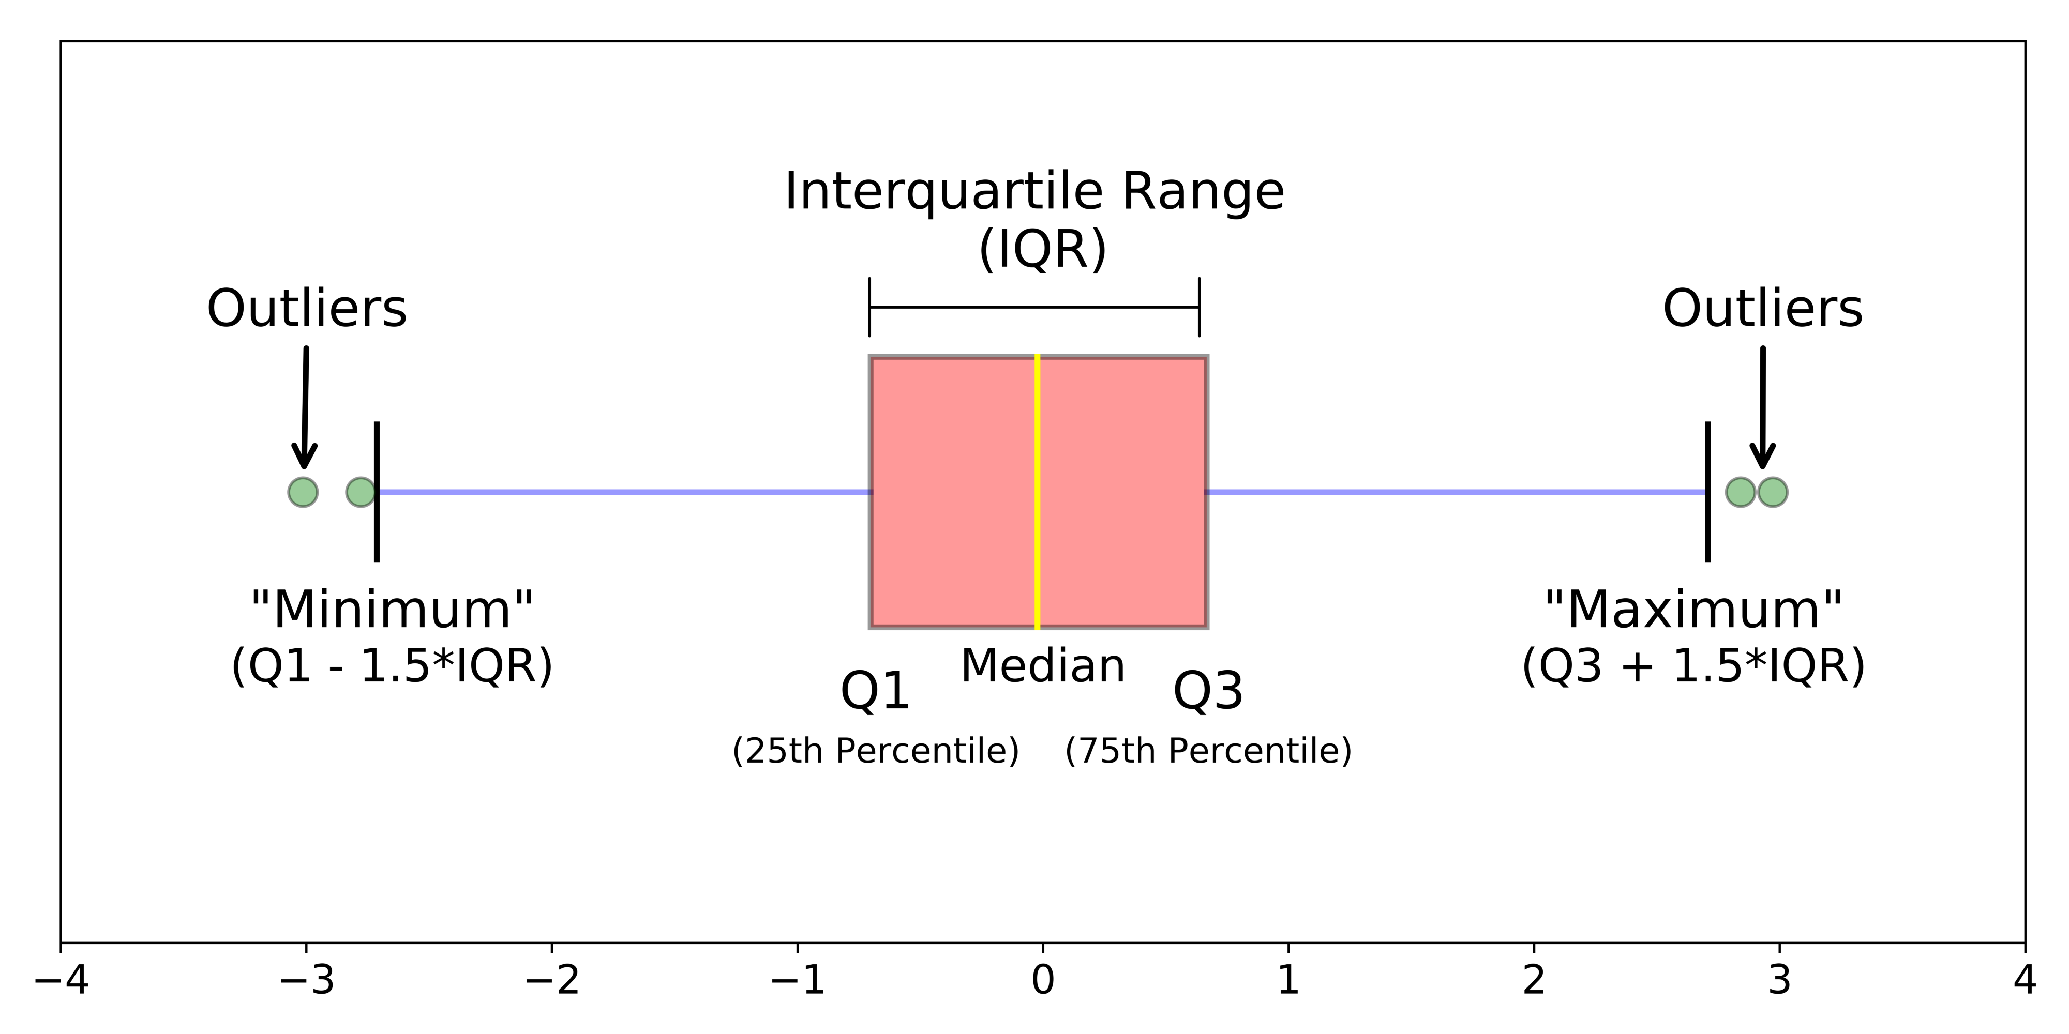
Box Plot

Slide 8
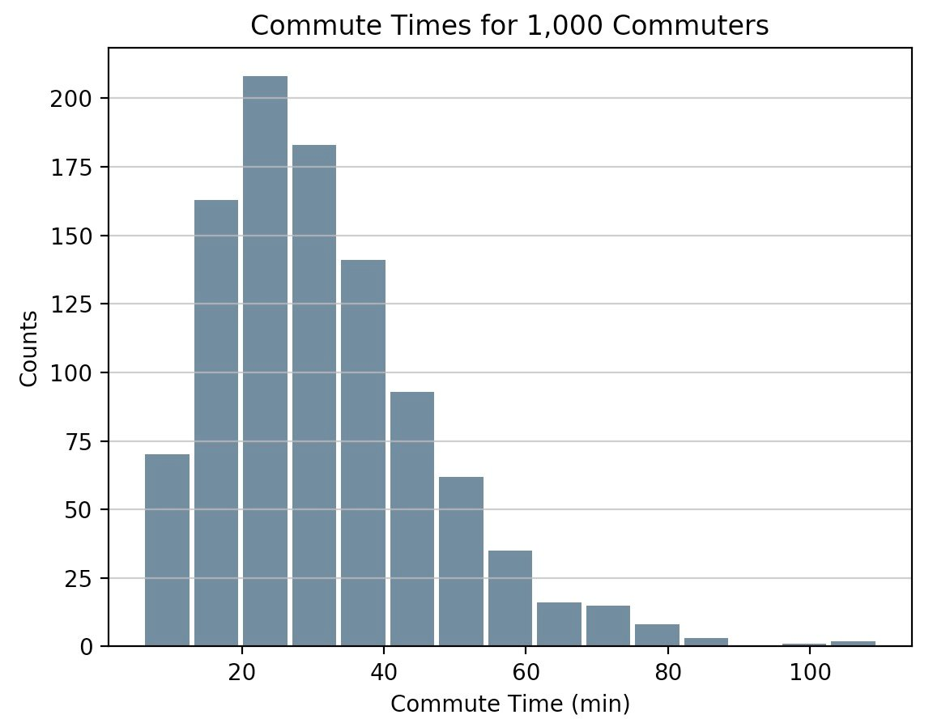
Histogram

Slide 9
03
What is Data Science?

Slide 10
Solving Problems using Data!
5 common problems:
Prediction : Numeric ( How much )
Prediction : Classes ( Classification )
Detection : Structure ( Clustering )
Detection : Anomaly ( Weird Behaviour)
Decision : Action ( Next action )
We will only be learning about the first 2 points using supervised learning!

Slide 11
Data Visualisation!
Convey your story effectively:
Expressiveness in a visual language
Show all the facts and only the facts
Readily perceived

Slide 12
04
Solving Problems
Let’s go!

Slide 13
THANK YOU

Slide 14
Resources
Photos
https://realpython.com/python-histograms
https://www.kdnuggets.com/2019/11/understanding-boxplots.html

